Slide 1
AOS Meeting November 19 2019
Information Technology: Technology Information

Slide 2
Getting Ready for Work Day, MFA, and the Microsoft unified collaboration platform

Slide 3
Work Day: How does it Work?

Slide 4
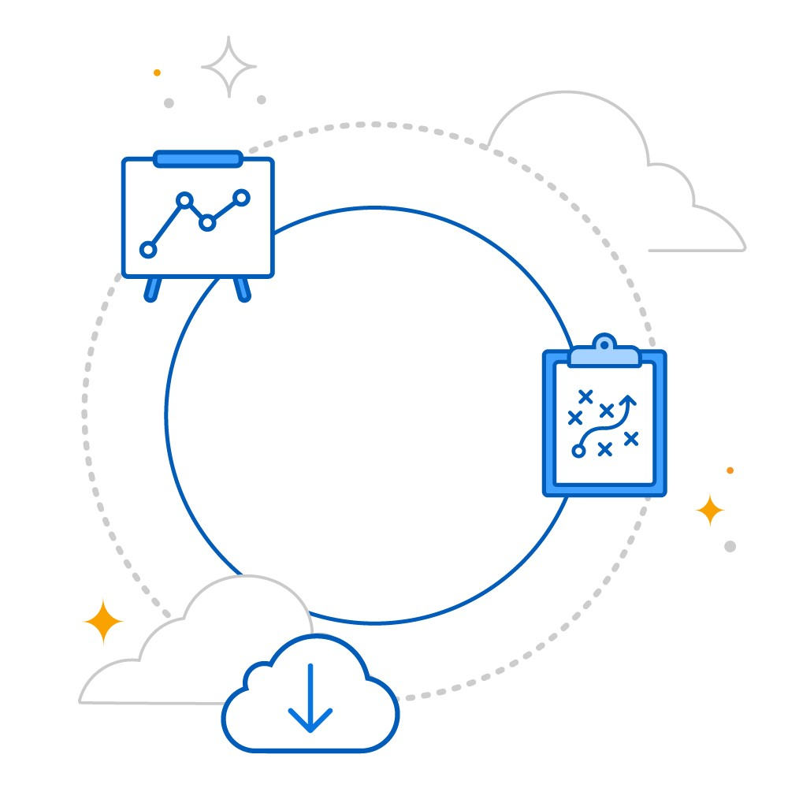
Why Are We Switching to Work Day?
Defining Processes and Security Roles
Top Down View of Organization
Visualize Data More Effectively
Increase Organizational Efficiency
Project One: One ring system to bind them all

Slide 5
Everything You Wanted to Know About Multifactor Authentication (MFA) but Were Afraid to Ask
Why multifactor authentication? Multifactor Authentication is just adding another layer to passwords much like your bank does now. Passwords will no longer expire but you will have to use a second method with each log in.
What are the different ways it can be realized? Smart Phone Authenticator App, SMS text message number, secondary email account, and hardware token
What are the pros and cons of each method? Authenticator is the easiest and fastest. SMS text can also go to your phone but takes a little longer. Secondary email also can work but do not have the same password. The final way is a hardware token but that will likely cause issues when you need to log in elsewhere and the expense will have to be paid by department.
Who will have to do it? Everyone. This does not make you eligible for a cell phone reimbursement per the UA System office. It also has no affect on FOIA status of your personal phone.
How do I get help as I go through the process? https://agritech.uark.edu/
https://agritech.uark.edu/help_support/knowledge_base/mfa.php

Slide 6
Microsoft Single Sign On (SSO)
What is Microsoft Single Sign On (SSO)?
What does it look like?
How will I change sign on credentials?
What does a B2B relationship mean?

Slide 7
Single Sign On Interface

Slide 8
VoIP: How Does It Work and What Does It Cost?
Phone Cost: approximately $200 one time cost, conference phone systems are approx. $800 but will work with Microsoft Teams and Zoom
Plan Cost: $9.00 a month
Minutes, Call Regions, and International Calls:
Each user gets 120 minutes per month that is in a shared pool of all users. Conference call in numbers for Teams will be an extra charge.
You can call anywhere in U.S. including Alaska, Hawaii, and Puerto Rico.
International calling is not included but can be added as needed. International video conferencing is included.
For more information: https://agritech.uark.edu/help_support/knowledge_base/voip.php

Slide 9
In Conclusion

