Slide 1
AOS Meeting
November 19, 2019
Notes:
The goal of this presentation is to provide a short overview of Project One

Slide 2
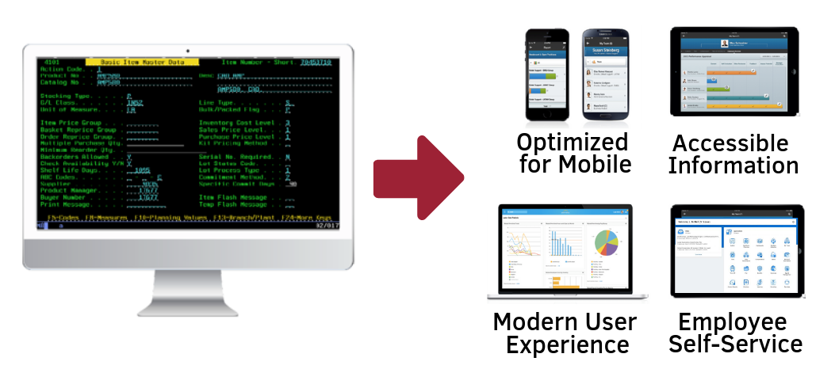
What is Project One?
Project One is the project to replace and update core administrative systems for Finance, Procurement, Human Capital Management, Payroll, and Student Administration within the University of Arkansas System.
Notes:
The UA System will be migrating from many different current states to one future state for HR, Finance, and eventually Student. Many legacy systems are at the end of their usable life, and having all institutions on the same system will allow for better reporting and sharing of resources. All UA Systems will transition to using Workday.

Slide 3
What’s the difference between Project One, ERP, and Workday?
Project One is the overarching project to replace and update core administrative systems within the University of Arkansas System.
ERP (Enterprise Resource Planning) is the type of software
Workday® is the specific software product purchased
Notes:
The UA System will be migrating from many different current states to one future state for HR, Finance, and eventually Student. Many legacy systems are at the end of their usable life, and having all institutions on the same system will allow for better reporting and sharing of resources. All UA Systems will transition to using Workday.

Slide 4
One System, One Solution
Powered by Workday
Notes:
After receiving proposals from 5 companies, Workday was awarded the software contract in August 2017. Workday has been implemented at a multitude of higher ed institutions, including state systems such as the Texas A&M System and the Louisiana State System.

Slide 5
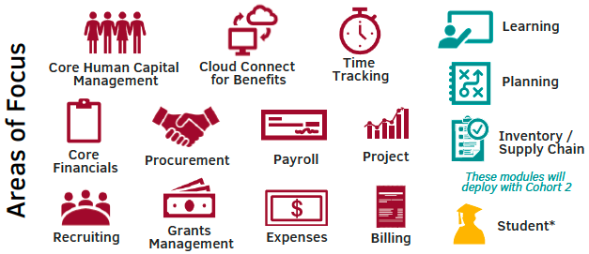
Functional Scope
Workday modules that are in scope of Project One.
*Workday Student has been purchased but is still in the pre-planning phase.
Notes:
These are the Workday modules that the UA System as purchased. Please note that Planning may have a different name by the time it is deployed. The three modules in teal will not deploy until Cohort 2, so Cohort 1 schools will still be involved in Cohort 2 to help configure these modules. Workday Student has been purchased by the UA System but there is not currently a timeline for it’s deployment.

Slide 6
Notes:
Operate as a System - As we design our Workday business process we should follow our guiding principles to harmonize our business processes as much as possible to enhance our ability to share and collaborate between institutions. The shared technology that Workday provides will allow employees more opportunities to transfer skills across the System.
As common as possible, as different as necessary - Workday’s optimized business processes will be our starting point for todays design session. Our goal is to have a single set of defined business processes across the entire UA System. Regulatory and legal requirements must be present to justify more than one instance of a business process.
Ensure one system of record - We want to ensure Workday is our system of record by minimizing the perpetuation of any shadow systems through interfaces.
Provide support to stakeholders - As we learn more about Workday Security and Security roles it will become clear that the deployment of Workday will change how everyone interacts with HR data, finance data, and payroll data. Throughout this project, the Project One team will provide support to Stakeholders to help manage the changes that are inevitable.
Craw. Walk. Run. - As we move throughout our design sessions, we should remember that not all of our problems that exist today will be solved and nor will every system be optimized during this first deployment. We should not allow the perfect to get in way of the good as we embark upon this first design of Workday.
Develop a common platform for future development - We need to think ahead to our future needs as we make our design decisions for Workday.

Slide 7
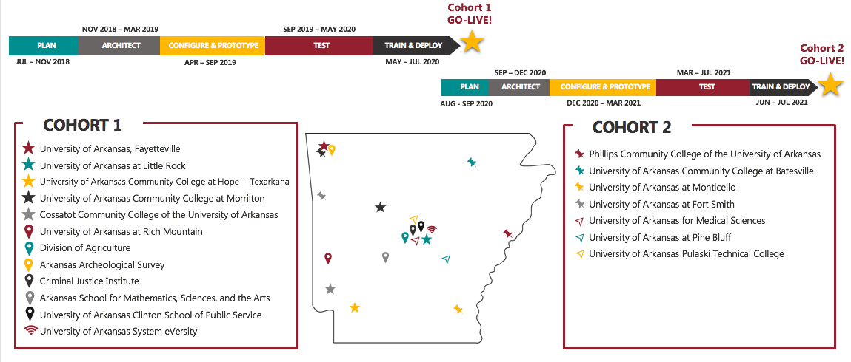
Timeline and Cohorts
Notes:
The project is broken into two cohorts, but both cohorts have been engaged thus far. Both cohorts participated in discovery sessions, design sessions, and local review sessions.

Slide 8
Key Institution Touchpoints
*Activities are not inclusive of all project activities. Dates are subject to change, dependent on project progress.
Notes:
This gives an idea of some of the activities contained in each stage. Cohort 2 participated in Discovery, Common Design, and Local Review sessions with Cohort 1 in Architect, however these activities will happen again in Cohort 2 as three new modules are being added. These are just a snapshot of the activities happening at each stage.

Slide 9
Key Institution Touchpoints
*Activities are not inclusive of all project activities. Dates are subject to change, dependent on project progress.
Notes:
These are just a snapshot of the activities happening at each stage. Depending on project progress, some events and dates could change.

Slide 10
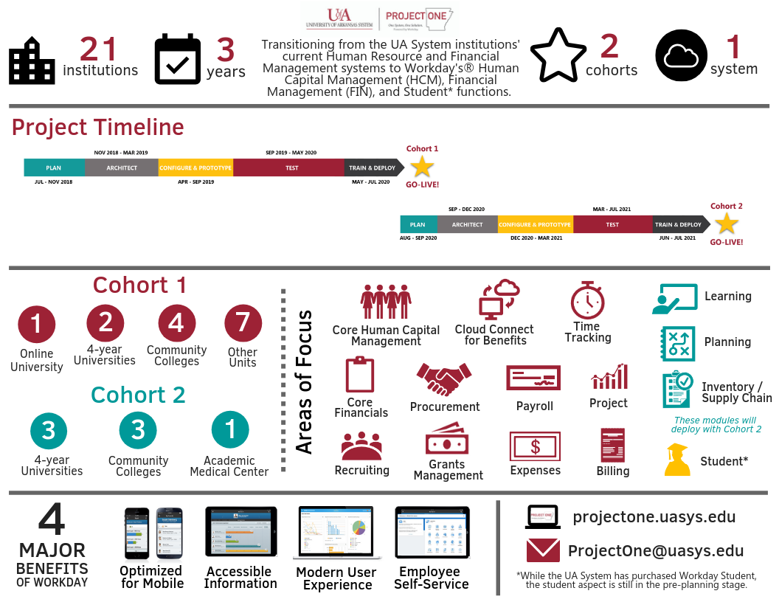
Project One Infographic

Slide 11
Institutional Representatives
Who from my campus is being consulted?
Subject Matter Experts
Each institution has a number of subject matter experts from HR, finance, and beyond that are contributing to the configuration of Workday.
Institution Project Coordinators
Melissa Cloud, UACCRM Margaret Cotton, CJI Matt Brown, UADA David Glover, UAPTC Jason Jaco, PCCUA Charlotte Johnson, CCCUA | Chuck Jordan, UACCHT Carol Miller, UAFS Paige Newell, UALR Anissa Ross, UAM Jay Parker, eVersity Amber Adams, UAF Steven Person, UACS | Lea Ramsey, UACCB Ashley Smith, ASMSA Willette Totten, UAPB Jim Bowling, UAMS Ronnie Wallingsford, UAMS Rachel Whitman, AAS Lisa Willenberg, UACCM
Notes:
In addition to Change Champions, other individuals on campus have been involved with the project thus far. Subject Matter Experts, or SMEs, from the functional areas have been helping design the business processes. The Project Coordinators have a direct line to the Project Director and make sure the right people on their campuses are being included in the process.

Slide 12
Things We Know:
BASIS, Razorbuy and PeopleAdmn will no longer be utilized
There will be a common supplier file throughout the system
Business Processes will change
Data access will change. Security roles will define access to information
Workday uses Multi Factor Authentication (MFA)
Senior leadership and PIs will have access to dashboards and reports
Managers and Supervisors will play a more significant role within Workday
Employee as self will have more opportunities within Workday to update personal information
A new system wide chart of accounts will be utilized. In Workday this is called a Foundation Data Model and will provide a single source of financial information.

Slide 13
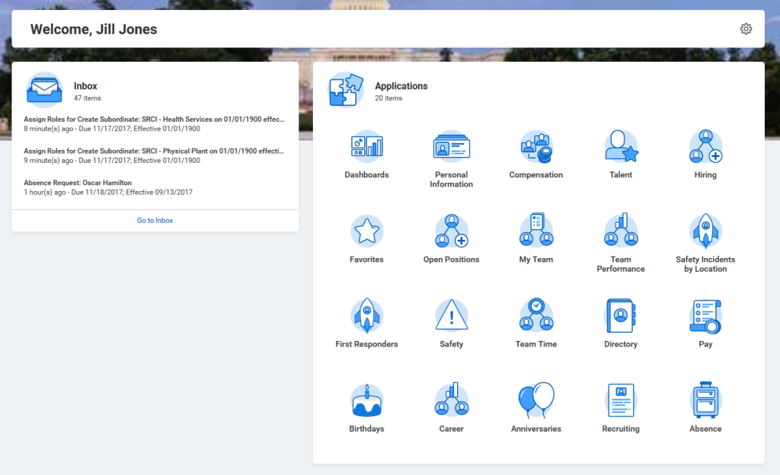
Example of An Employee’s Home Page:
Allowable “Worklets” will depend on the security roles you have been assigned.

Slide 14
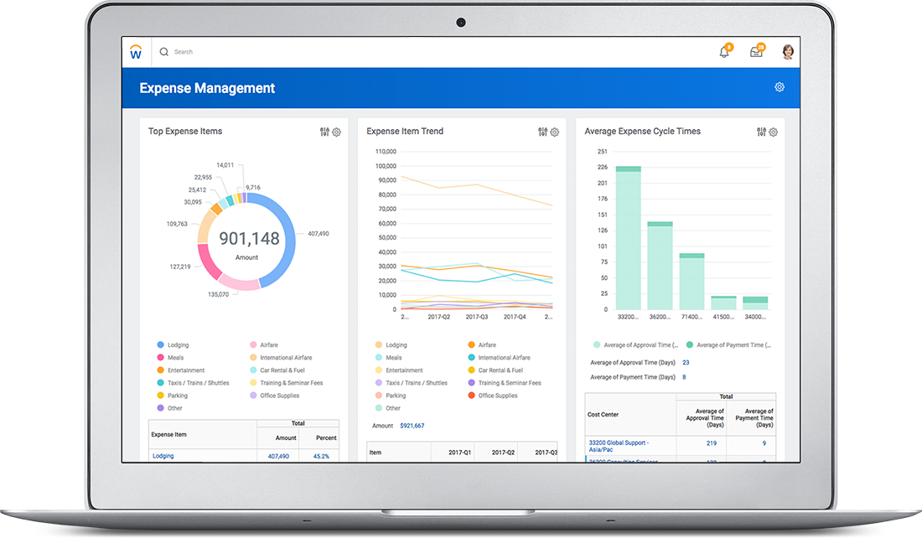
Example of a Manager’s Dashboard Capability:

Slide 15
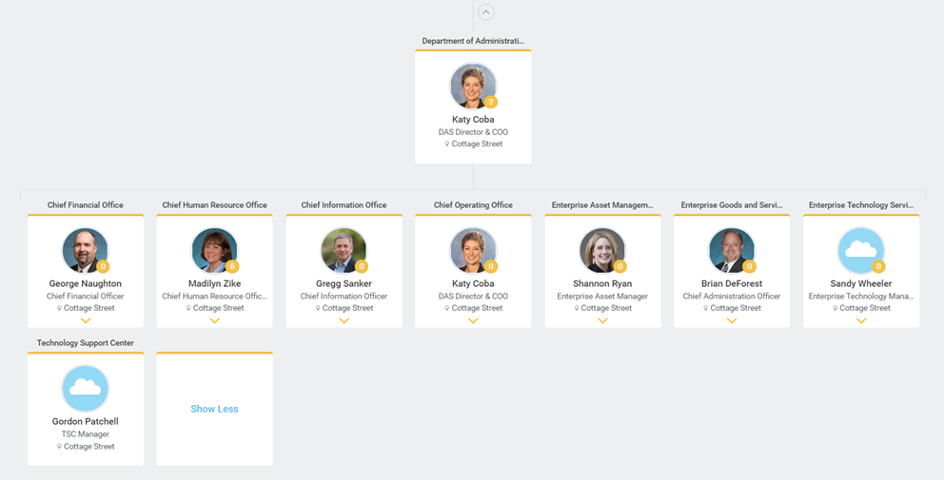
Example of Supervisory Organization:

Slide 16
Next Steps
Testing
End to End Testing
Executing scenarios and workflow processes from start to finish
Two cycles – one in December and January, another in February to test the resolution of defects identified in the first cycle
Project One team will start the testing in November 2019
SMEs and other institution testers will begin testing in January 2020
User Acceptance
Testing scenarios as a team based on security roles
Project One team will start testing in January 2020
SMEs and other institution testers will begin testing in March 2020
Payroll Compare
Two payroll runs
Notes:
More background about the project can be found at projectone.uasys.edu. This page will also be kept up-to-date with project progress and houses many FAQs.

Slide 17
Next Steps
Training
May and June
Multiple formats
Job Aid/Quick Reference Guide: easy-to-use guides that provide information on key concepts, terminology, and the business process
Computer-based Training: self-paced learning modules for users whose work processes will have limited changes in Workday.
Virtual Instructor-led training: recorded Zoom learning session with an instructor presenting course materials, demonstrating processes, and answering questions for users whose work processes will be moderately impacted by Workday.
Instructor-led training: hands-on classroom training for users whose work processes will be dramatically affected by Workday.
Notes:
More background about the project can be found at projectone.uasys.edu. This page will also be kept up-to-date with project progress and houses many FAQs.

Slide 18
What can you do?
Clean up your data
Close out old cost centers
Delete old POs and TAs
Delete PAPCs
Get organized
Be proactive
Find out more about Workday
Familiarize yourself with the new terminology
Notes:
More background about the project can be found at projectone.uasys.edu. This page will also be kept up-to-date with project progress and houses many FAQs.

Slide 19
Learn More About Project One
Visit the Project One websites
projectone.uasys.edu workday.uark.edu
Sign up for the Project One monthly newsletter
Visit the “Contact Us” page at projectone.uasys.edu
Contact your Project Coordinator
Stay in touch with your Change Champion
Notes:
More background about the project can be found at projectone.uasys.edu. This page will also be kept up-to-date with project progress and houses many FAQs.

